Slide 1
Indian Sign Language Detection Literature Survey
Team Members
Ajith.J (CB.EN.U4CSE09405)
Karthick.K.S (CB.EN.U4CSE09415)
Niranjan.M (CB.EN.U4CSE09427)
Saipreethy.M.S (CB.EN.U4CSE09443)
Shangeetha.R.K (CB.EN.U4CSE09447)
Valliammai.V (CB.EN.U4CSE09454)
Guide: Ms.S.Padmavathi Co-Guide: Mr.Raghesh Krishnan

Slide 2
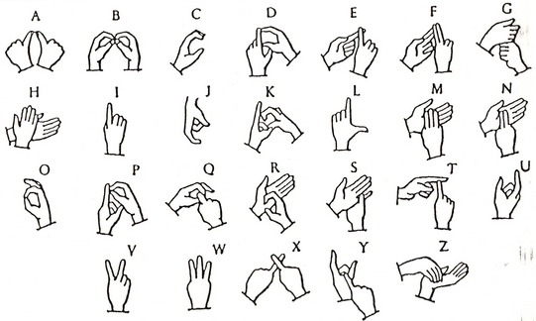
Problem Statement
To implement a combination of gesture recognition techniques, for developing a robust and efficient system which is capable of detecting Indian Sign Language.
Input: Hand gestures captured by a webcam.
Output: The sign corresponding to the gesture in text format.

Slide 3
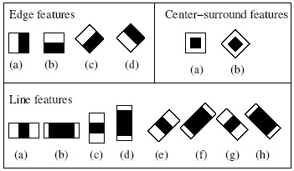

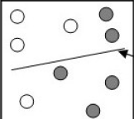
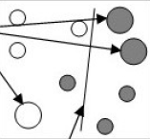
Haar Features
Haar like Features
Internal imaging
Ratio between dark and white areas
AdaBoost learning algorithm
Improves accuracy
Brightness is not an issue

Slide 4
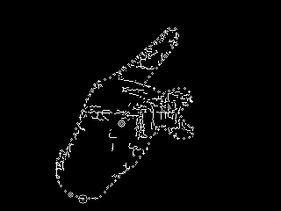

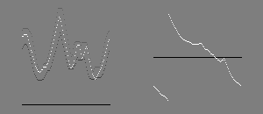
Vision-based static gesture recognition using norms
Color segmentation using hue saturation
Extracting contour
Comparison using 4 norms
F and T not identified
Only for static images
Contour image
Radius and angle vs arc length and radius

Slide 5
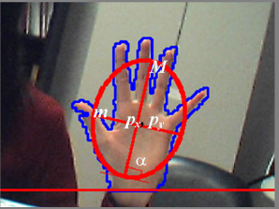





Real time hand gesture recogntion for dynamic application
Image pre-processing
Tracking proceure
Only for start,move and stop
For video games

Slide 6


Support Vector Machines
Blob Analysis
Re-orientation
State Vector Machines
hue and saturation: 0.12≤S≤0.4, 0.93≤H≤1 or 0≤H≤0.137.
RNorm=R-Ravg+1/2

Slide 7
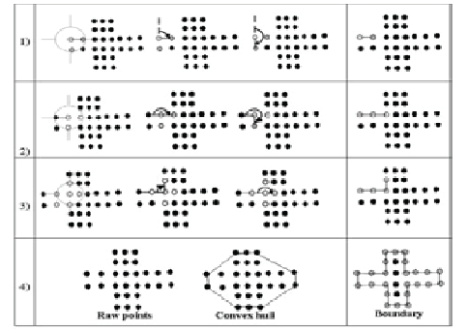
Range Cameras
Range Cameras
Levels of segmentation
Number of Raised Fingers
Convex hull based boundary
detection
Douglas-Peuckes Algorithm
Number of U-Turns
Manipulation of
moving object

Slide 8
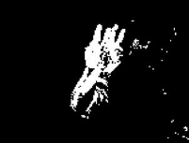
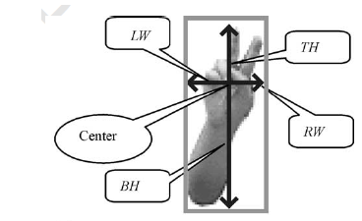
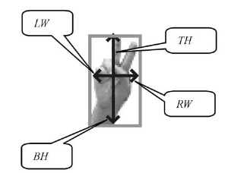
Hidden Markov Models
Motion Detection
Skin Color Extraction
Edge Detection
Extraction of region of Interest by numbering

Slide 9
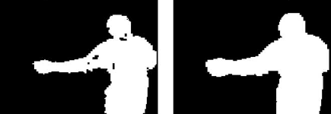
Neural Nets
Background Subtraction
Fourier Descriptor
Rank Based Approach
ANN
{Positionleft; Orientationleft ; HandShapeleft; Positionright; Orientationright; HandShaperight}
Overcoming co-articulation
Bigram Language Models
Pruning

Slide 10
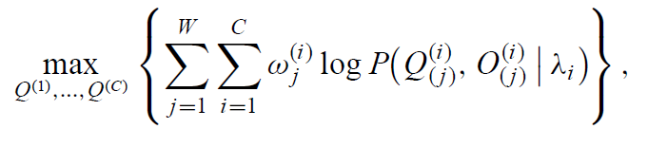
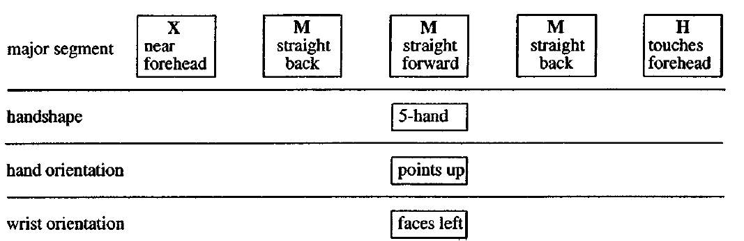
Parallel HMMs
Factorial Hidden Markov Model
Coupled Hidden Markov Model
Parallel Hidden Markov Model
Movement Hold Principal

Slide 11
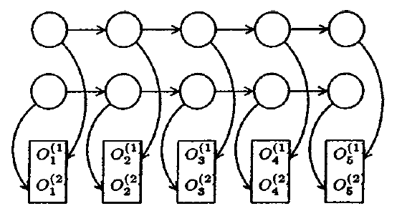
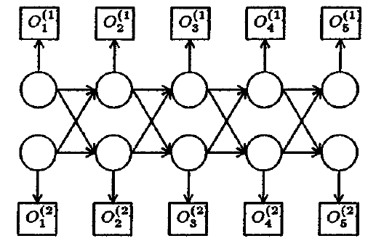
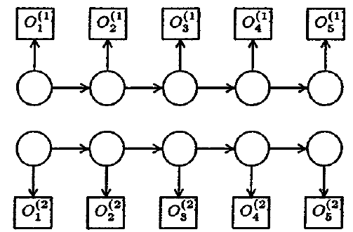
Parallel HMMs Cont…
Advantages
Tractable solution
Limitations
Movement Epenthesis

Slide 12
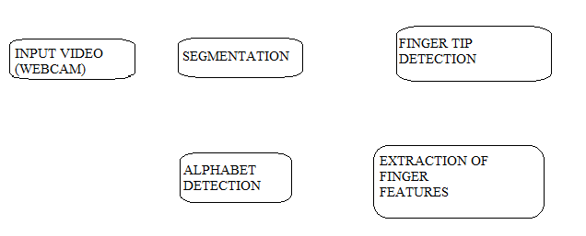
Architecture of the System
Notes:
Objectives for instruction and expected results and/or skills developed from learning.

Slide 13
References
Hervé Lahamy and Derek Litchi, “Real Time Hand Gesture Recognition using Range Cameras”.
Elena Sánchez-Nielsen, Luis Antón-Canalís, Mario Hernández-Tejera,” Hand Gesture Recognition for Human-Machine”.
Isaac García Incertis, Jaime Gómez García-Bermejo, Eduardo Zalama Casanova, ” Hand Gesture Recognition for Deaf People Interfacing”.
Feng-Sheng Chen, Chih -Ming Fu, Chung-Lin Huang,” Hand gesture recognition using a real-time tracking methodand hidden Markov models”(2003)
Wen Gao, Jiong Ma, Jaingqin Wu, Chunli Wang,” Sign Language Recognition Based on HMM/ANN/DP”.
Christian Vogler and Dimitris Metaxas,” A Framework for Recognizing the Simultaneous Aspects of American Sign Language”(2001).
Ilan Steinberg, Tomer M. London, Dotan Di Castro,”Hand Gesture Recognition in Images and Video“
Qing Chen, Nicolas D. Georganas, Emil M. Petriu,” Real-time Vision-based Hand Gesture Recognition Using Haar-like Features”(2007)
Notes:
Relative vocabulary list.

Slide 14
THANK YOU

